Slide 1
Hardware Security
Secure Hardware Computing

Slide 2
Disclaimer
not following a course from anywhere
might seem boring - not much pwnage
You don’t like something, something is unclear - tell me

Slide 3
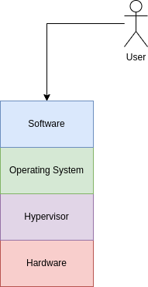
Intro
everything relies on the hardware
break the hardware, you can break everything else
very hard to exploit
very costly to mitigate the exploits

Slide 4
Topics
how can the hardware help us compute stuff
how the hardware guarantee the safety of our data
how can the hardware isolate resources; between VMs, between kernel and user
some attacks - maybe

Slide 5
Hardware Computing: Cryptography
word of the day: speed
Intel, AMD, ARM: AES, SHA
Other implementations: RISC-V, PowerPC, IBM
disadvantage: to use the hardware instructions, you must know the algorithm very well

Slide 6
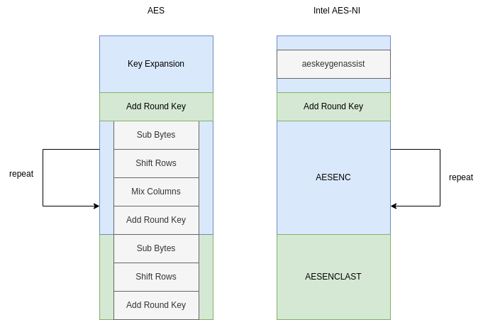
Intel AES-NI
uses SSE2 registers and instructions
no reported attacks
theoretical attack: local side-channel attack

Slide 7
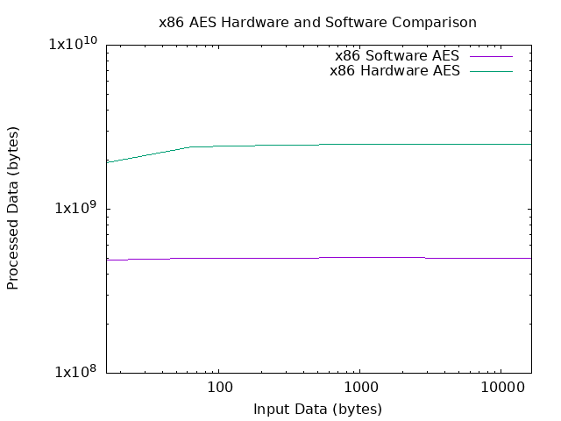
Intel AES-NI

Slide 8
ARM Cryptographic Extension
optional for CPU producers
you must find a board that uses it
demo: Raspberry PI 4B vs Orange Pi 5

Slide 9
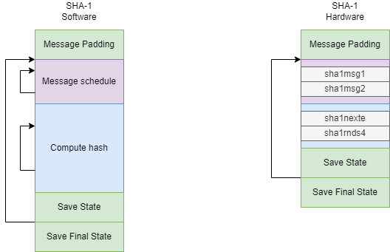
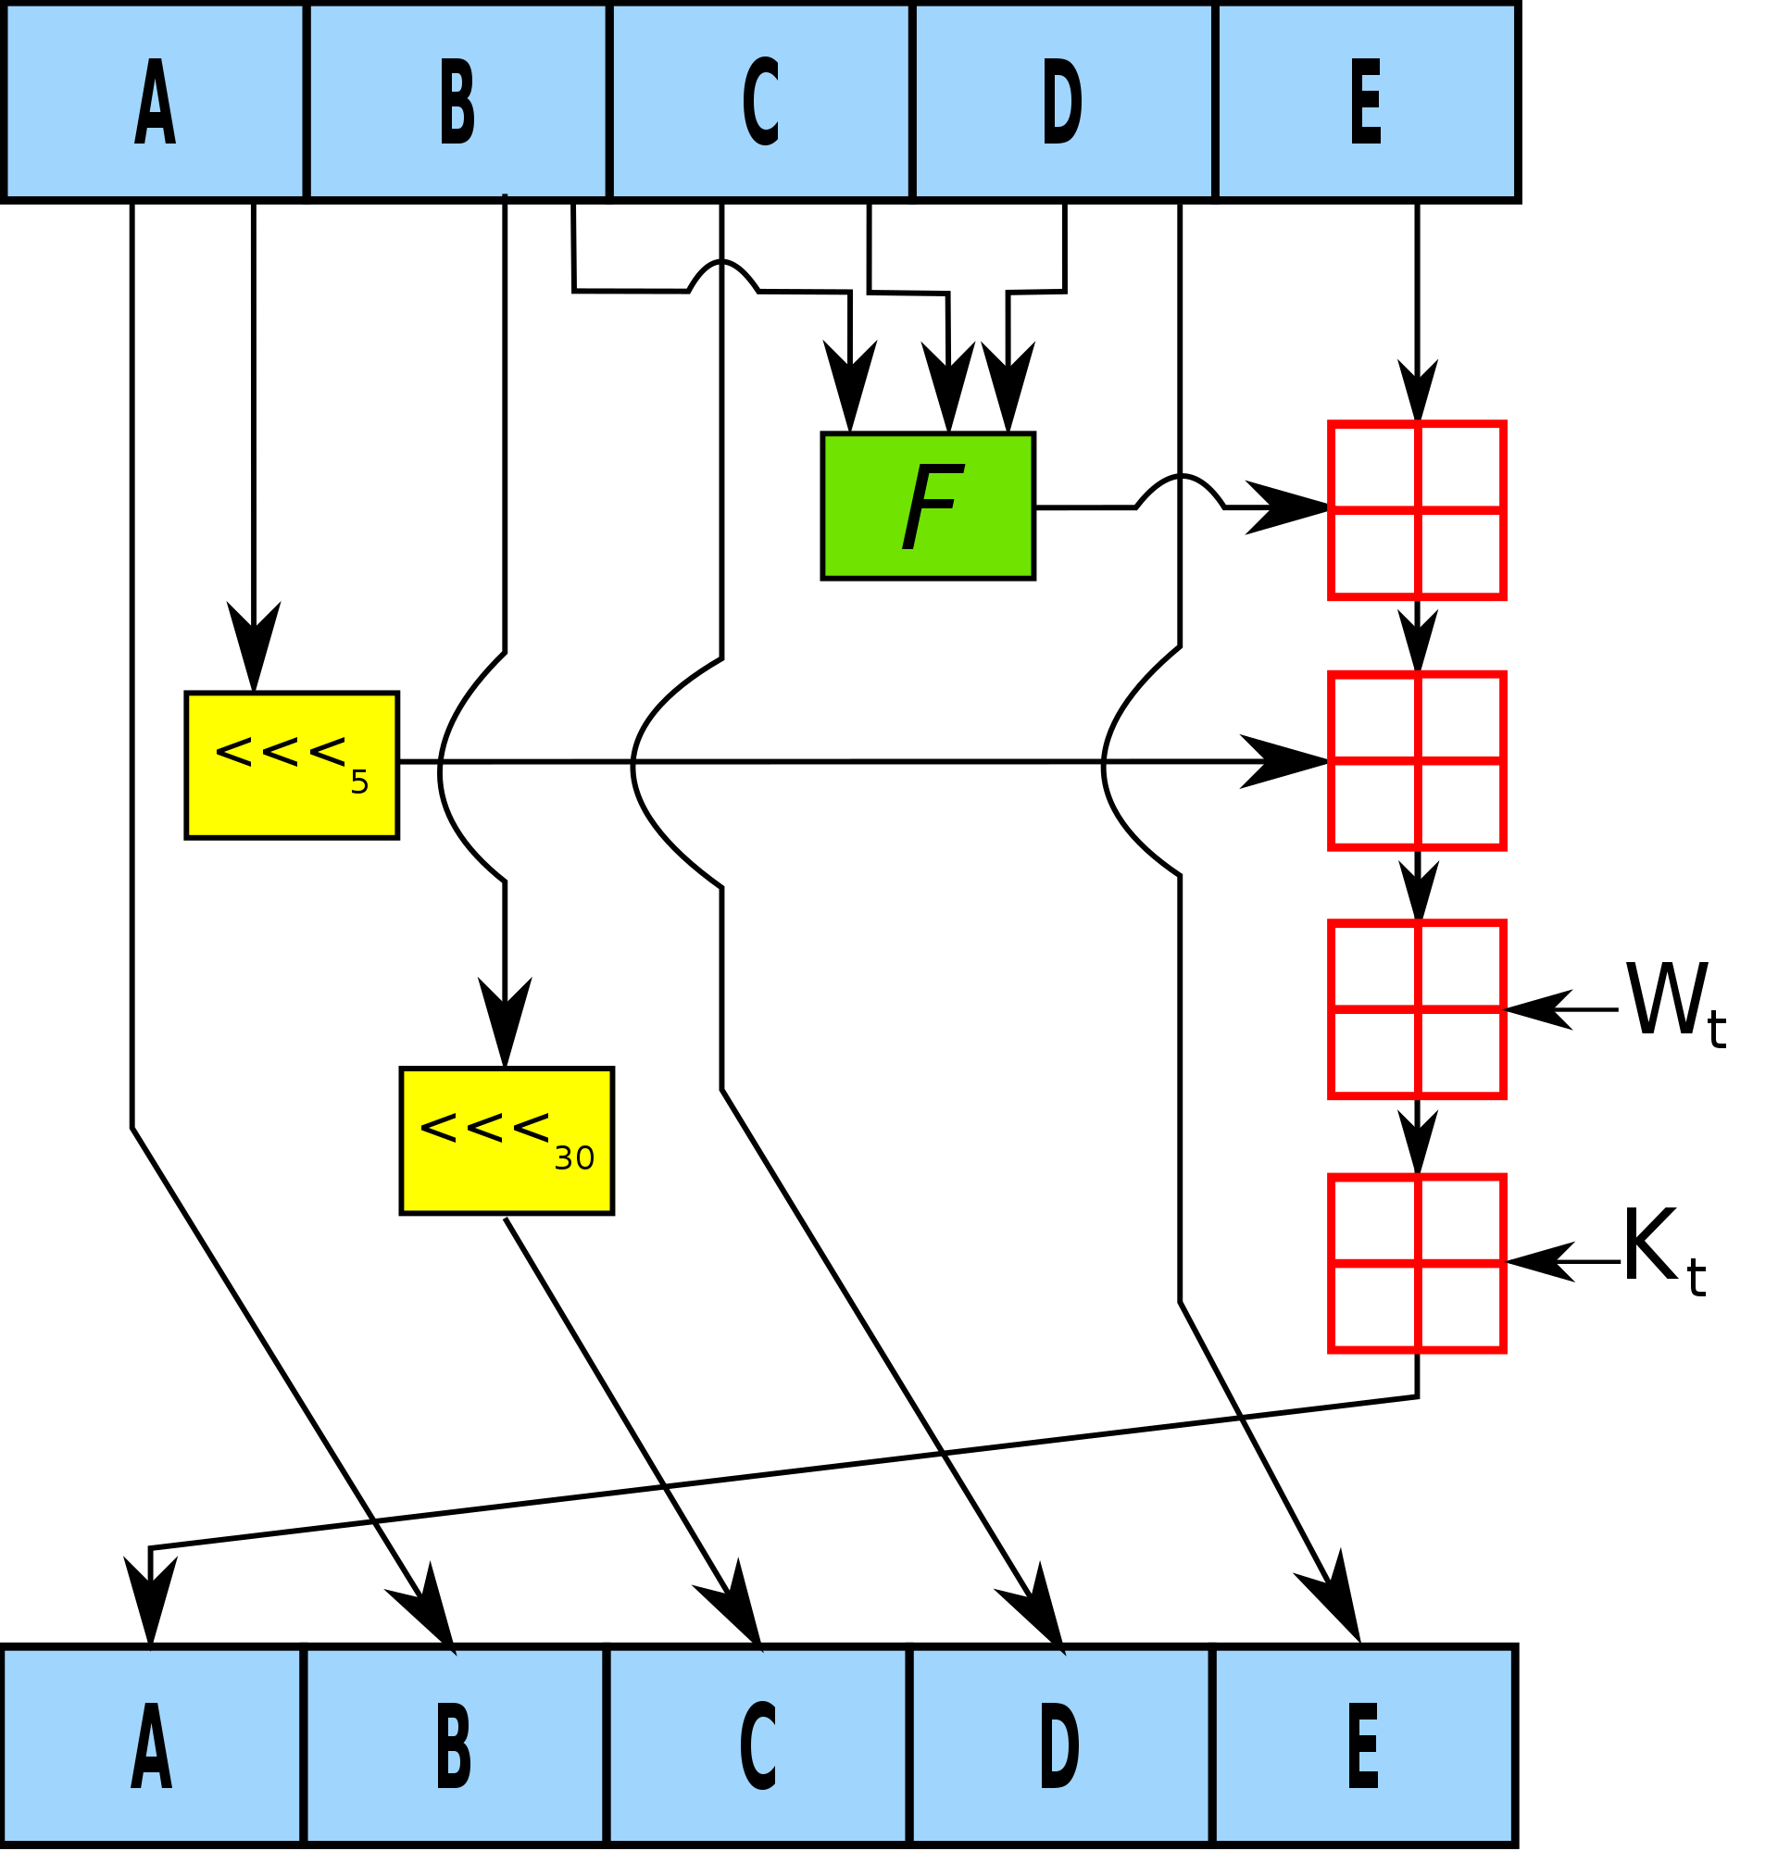
Intel SHA-NI

Slide 10
Hardware Computing: Random Numbers
essential for all cryptographic operations
true randomness can’t be achieved
PRNG - pseudo-random number generator
entropy - the quantity of randomness in the system
a normal user can’t generate reliable random numbers
must rely on OS or hardware
OS: /dev/urandom

Slide 11
Intel RDRAND and RDSEED
used to read from Intel’s PRNG
rdrand vs rdseed
rdrand should be faster
rdseed should be impossible to predict - both are impossible to predict
they can (could) be intercepted
CrossTalk, ZombieLoad and Co

Slide 12
CrossTalk - Overview
cross-core staging buffer reading
extremely hard to replicate
not so destructive - you can read some random numbers from another core
very bad for SGX enclaves
mitigated by Intel

Slide 13
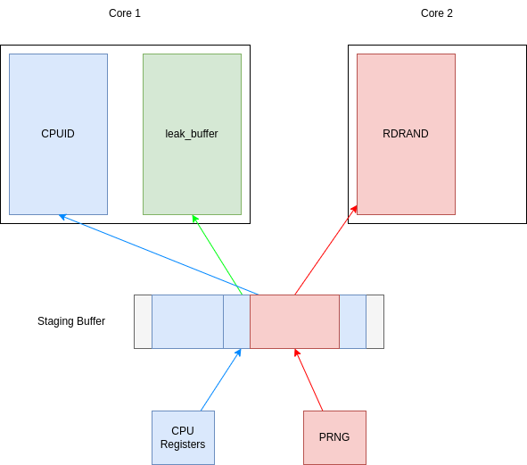
CrossTalk - Theory Behind
one core can read information destined for another core
data is stored in a buffer, before being sent to the core
the buffer isn’t flushed before another core uses it
cpuid - known output, uses the buffer

Slide 14
Trusted Computing
can we trust the machine (the hardware)?
a protocol to ensure the system isn’t altered
implementation: TPM

Slide 15
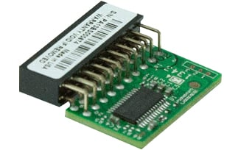
Trusted Platform Module
a hardware chip, implemented in BIOS or in the CPU
stores the initial state of the system, when booting
stores encryption keys or sensitive data
allows access to them if the system isn’t altered by untrusted hardware / software
endorses current system
attests that other systems can be trusted

